Slide 1







Enterprise Blockchain Developers (Intermediate)
In support of
Powered By

Slide 2
Outline
What is Consensus
Byzantine General's Problem
The Enlightenment of BGP and POW
© 2017-2020 SmartMesh Foundation Pte. Ltd. | MeshBox Foundation Pte. Ltd.

Slide 3
What is Consensus?
A consensus mechanism is a fault-tolerant mechanism that is used in computer and blockchain systems to achieve the necessary agreement on a single data value or a single state of the network among distributed processes or multi-agent systems
What if there is a malicious node?
Byzantine General's Problem

Slide 4
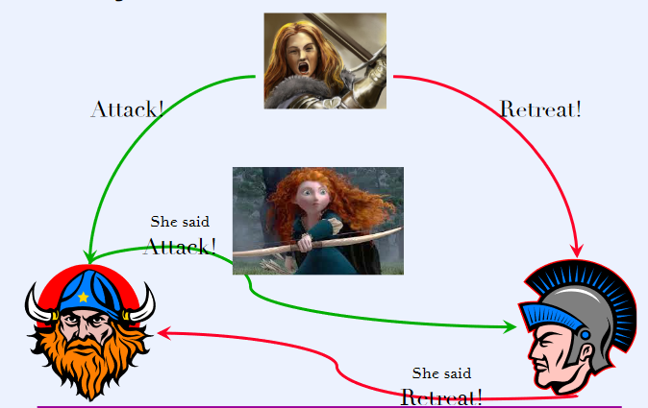
Byzantine General's Problem
if the General is malicious n = 3 t = 1

Slide 5
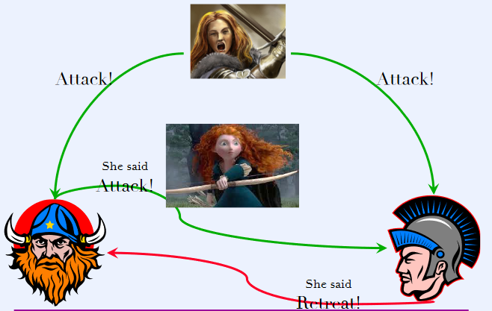
Byzantine General's Problem
if one of the lieutenant is malicious n = 3 t = 1

Slide 6
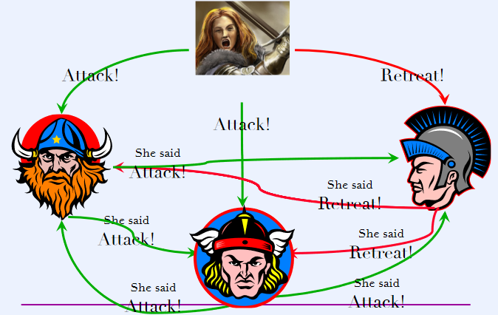
Byzantine General's Problem
if the General is malicious n = 4 t = 1

Slide 7
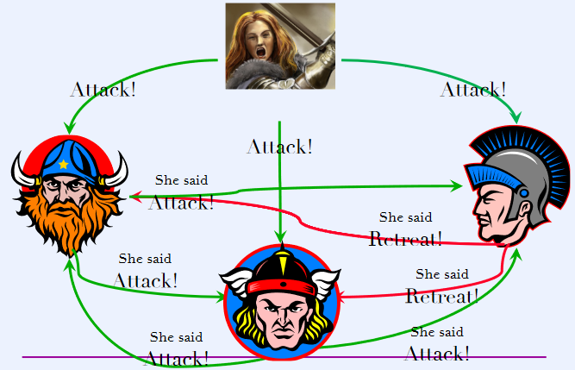
Byzantine General's Problem
if one of the lieutenant is malicious n = 4 t = 1

Slide 8
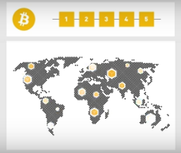
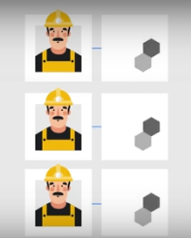
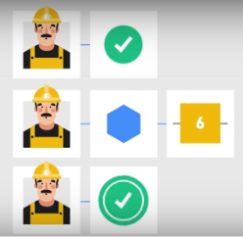
The Enlightenment of BGP and POW
What is POW?
Double Spending
n > 3t, where n is the number of nodes and t is the number of the malicious nodes, then the system is called Byzantine fault-tolerant

Slide 9
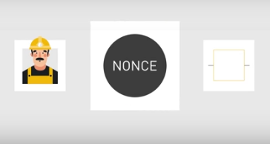
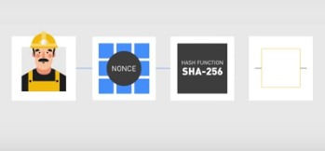
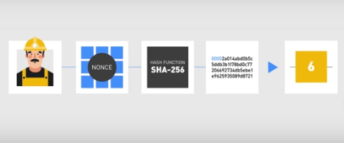
The Enlightenment of BGP and POW
What is POW?

Slide 10
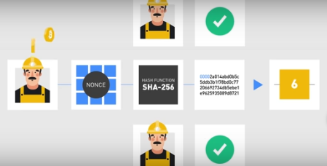
The Enlightenment of BGP and POW
Nonce and Difficuty
let’s imagine for a moment that the hashing algorithm consists of picking up a number at random from a pool of equally possible values, like in a lottery. For the sake of simplicity, let’s say that the range of the possible values goes from 0 to 100, and that we win if we pick a number that is smaller than or equal to a target T

